Slide 1
Data Control and Functions
Lesson #4

Slide 2
Command ‘read’

Slide 3
Command ‘read’
Provides a means entering variable data while the shellscript is executing
Operator prompting should be provided
  ‘echo’ or ‘print’ commands
  ‘?’ option of the ‘read’ command
System Variable “$REPLY” maybe used to store data if user variable is not supplied

Slide 4
Command ‘read’
# read var1
123456789
# echo $var1
123456789
# read
abcdefghi
# echo $REPLY
abcdefghi
#
Format #1
Format #2

Slide 5
Command ‘read’ with prompt
# read var1?Enter Value:
Enter <cr>
/bin/ksh: Value:: This is not an identifier.
# read var1?"Enter Value: "
Enter Value: 123456789
# echo $var1
123456789
#
Format #3

Slide 6
Sample shellscript #1
# cat read_sample1
tput clear
echo 'Enter value_one and value_two'
read value_one value_two
echo "First value = $value_one"
echo "Second value = $value_two"
echo "Enter value_three"
read
echo $REPLY
#
Prompt
Prompt

Slide 7

Sample shellscript # 1
# read_sample1
Enter value_one and value_two
1 2 3 4
First value = 1
Second value = 2 3 4
Enter value_three
5 6
5 6
#
Space Separated
TAB Separated

Slide 8
Sample shellscript #2
# cat read_sample2
tput clear
print '\t\t' Enter Value one
read value1
read value2?"Enter Value two: "
echo "Value one = $value1"
echo "Value two = $value2"
#
Prompt
Read / Prompt

Slide 9
Sample shellscript #2
# read_sample2
Enter Value one
1 2 3
Enter Value two: 4 5 6
Value one = 1 2 3
Value two = 4 5 6
#
Prompt from ‘print’
Read command prompt

Slide 10
Commands ‘cut & grep’

Slide 11
Command ‘cut’
Extracts data Fields or Columns from a file, variable or output data stream
Format #1:
  cut -f <number of fields> -d <delimiter>
Format #2:
  cut -c <number of characters>

Slide 12
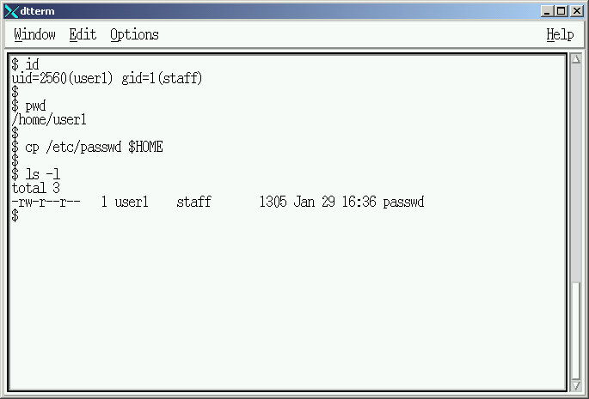
Creating lecture testing file

Slide 13
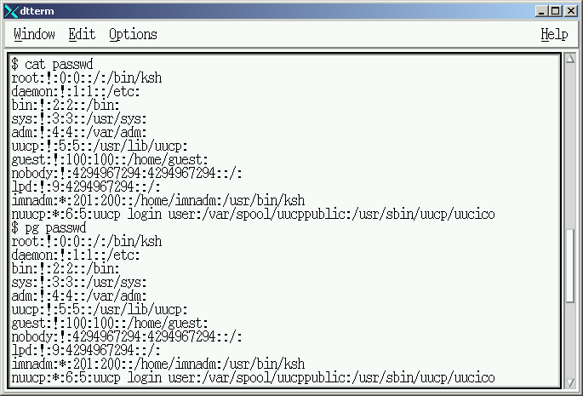
Display “:” Separtated File

Slide 14
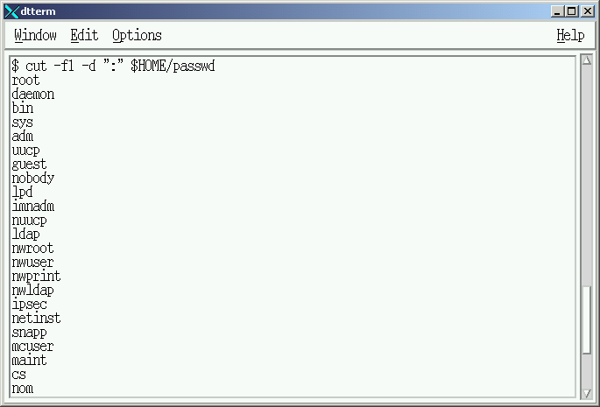
Display 1st Column

Slide 15
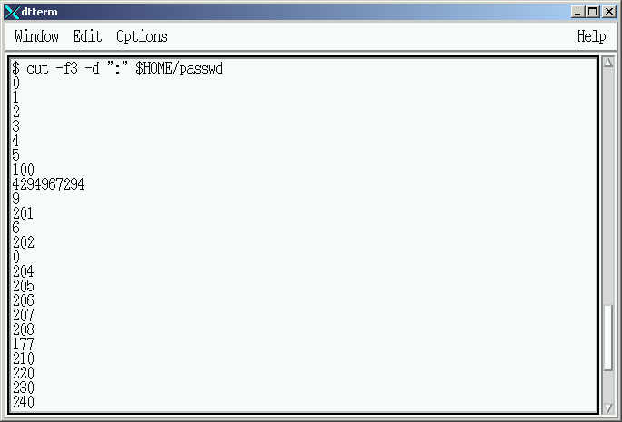
Display 3rd Column

Slide 16
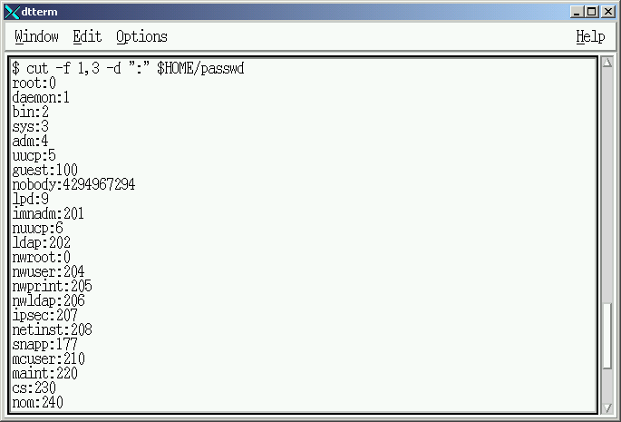
Display 1st and 3rd Columns

Slide 17
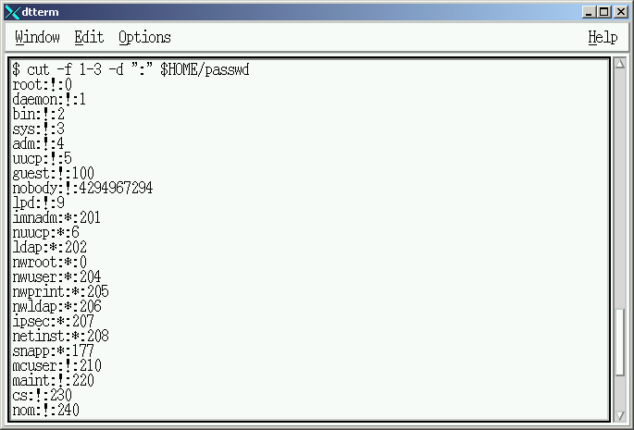
Display 1st thru 3rd Columns

Slide 18
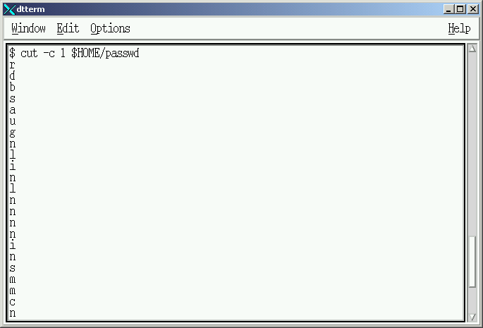
Display 1st Character

Slide 19
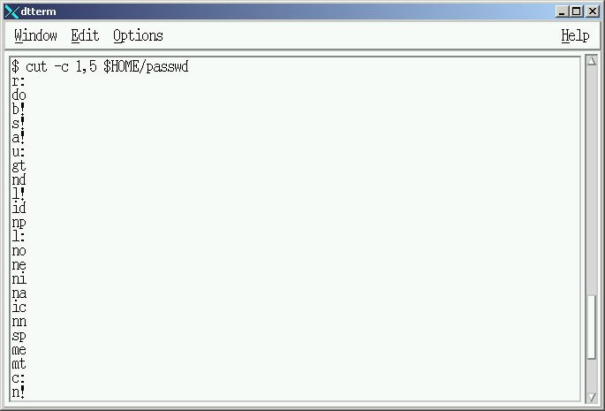
Display 1st and 5th Characters

Slide 20
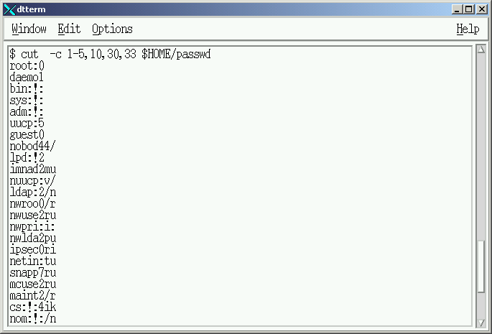
Display a variety of Characters

Slide 21
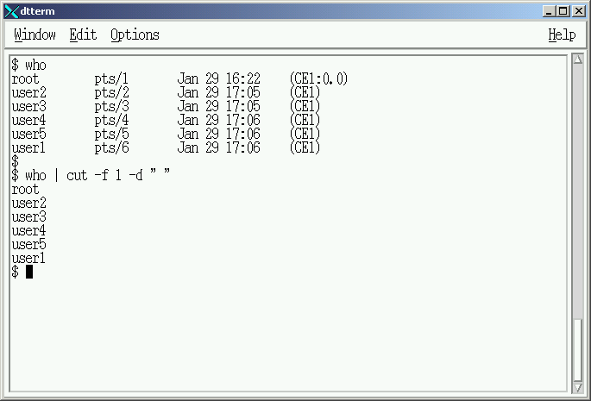
Cutting Command Output

Slide 22

Cutting Command Output

Slide 23
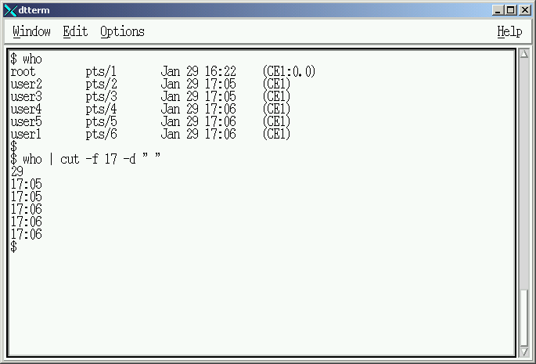
Cutting Command Output

Slide 24
Classroom Exercise
Using the ‘who’ command, find the number of delimiters required to display the following information pretaining to YOU.
  user name
  window device (PTS)
  Month, Date, Time
  IP Address (Location)

Slide 25
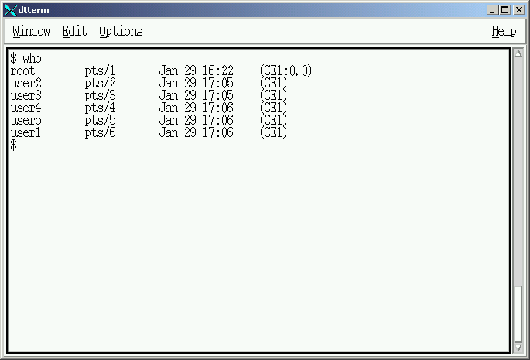
Sample Result
1 8 15 16 17 21

Slide 26
Command ‘grep’
Selects output lines containing specific strings
Format #1:
  grep <“string value”>
Format #2:
  grep -v <“string value”>

Slide 27
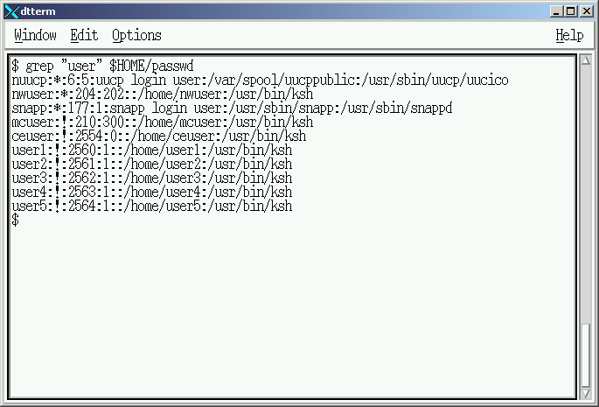
Select output containing string

Slide 28
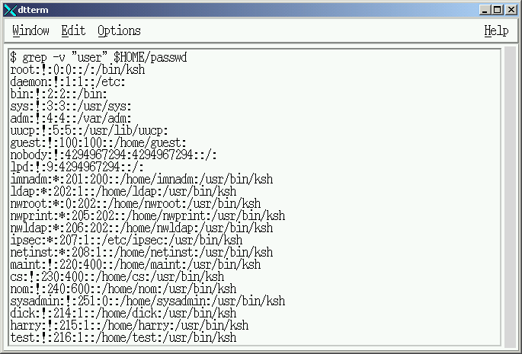
Select output NOT containing string

Slide 29
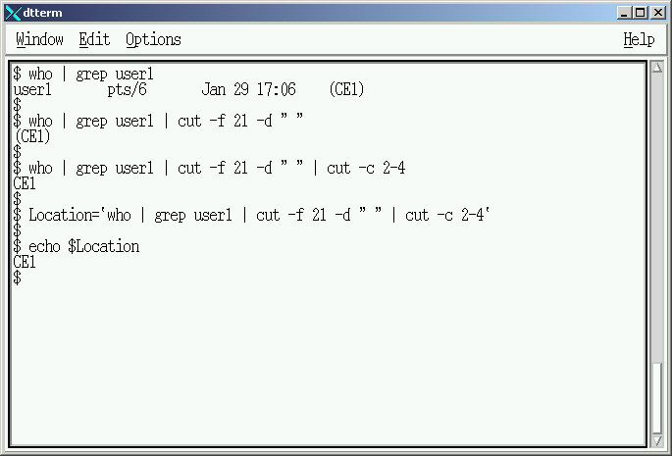
Combining ‘cut’ and ‘grep’

Slide 30
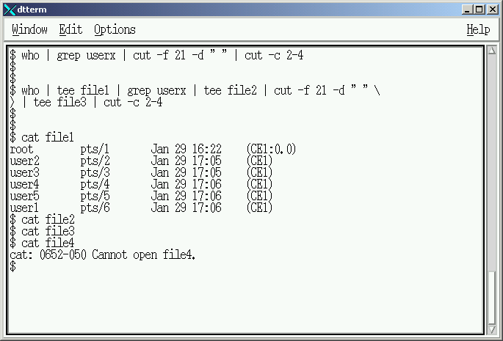
Pipeline Debugging

Slide 31
Functions

Slide 32
What are Functions?
Common routines executed multiple times
Routine coded ONCE
Function can be LOCAL or GLOBAL
Functions are stored in Real Memory

Slide 33
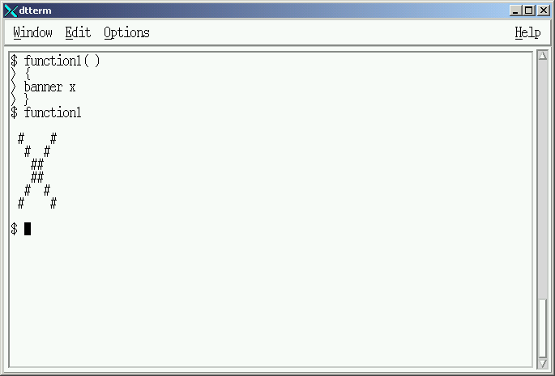
Bourne / Korn Shell

Slide 34
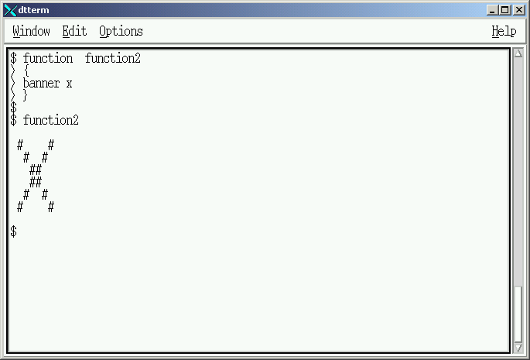
Korn Shell ONLY

Slide 35
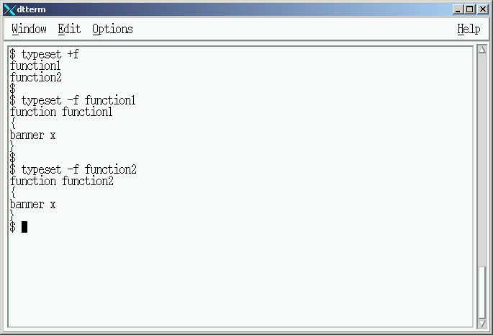
Displaying Memory Functions

Slide 36
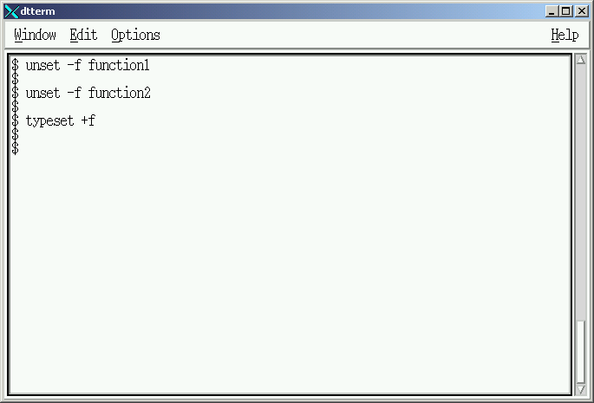
Removing Memory Functions

Slide 37
Local Function – create “script1”
function display1
{
banner xxx
sleep 2
}
#
echo "Beginning of Script1"
sleep 2
#
display1
#
echo "Script1 Termination"
sleep 2

Slide 38
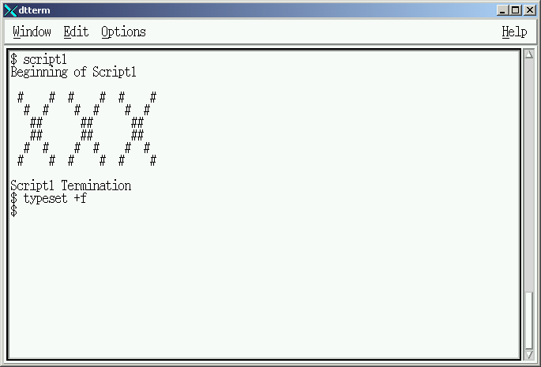
Execution of ‘script1’

Slide 39
Variable Passing – create “script2”
function display1
{
banner $1
func_name=`typeset +f `
echo “Function Name: $func_name”
sleep 2
}
#
echo "Beginning of Script1"
sleep 2
#
Display1 Dick
#
echo "Script1 Termination"
sleep 2

Slide 40
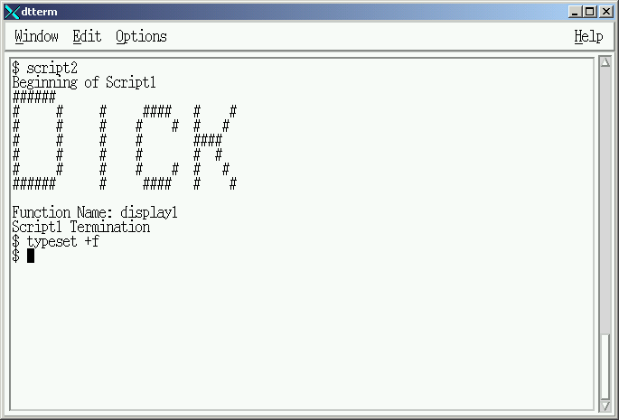
Execution of ‘script2’

Slide 41
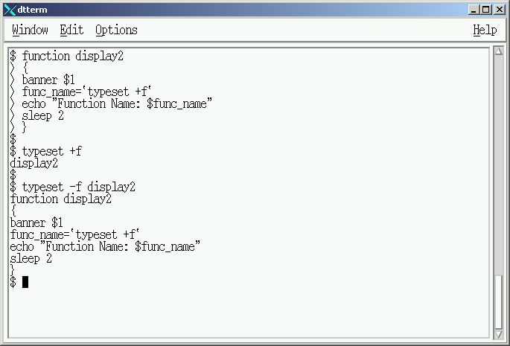
Memory Resident GLOBAL Functions

Slide 42
Global Function – create “script3”
echo "Beginning of Script1"
sleep 2
#
Display1 Dick
#
echo "Script1 Termination"
sleep 2

Slide 43
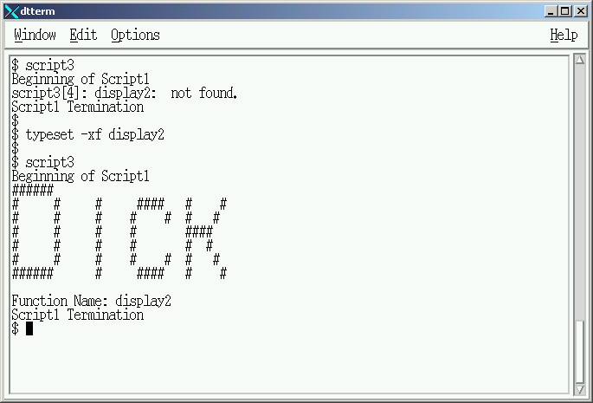
Execution of ‘script3’

Slide 44
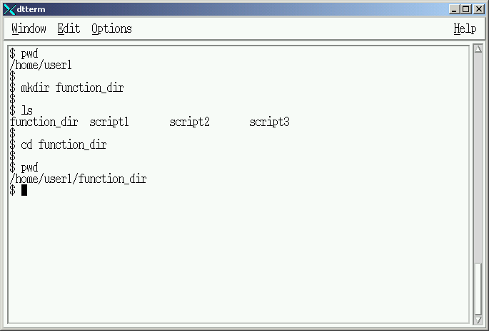
Creating a Directory of Functions

Slide 45
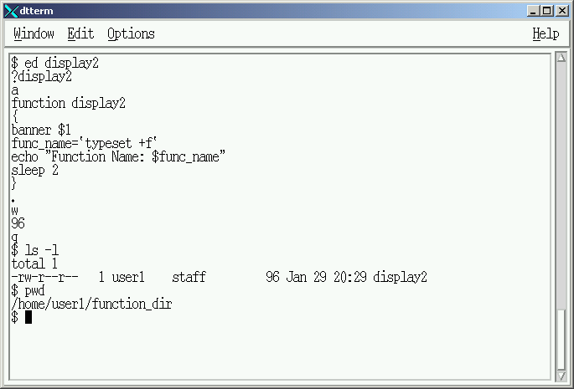
Creating a Disk Resident Functions

Slide 46
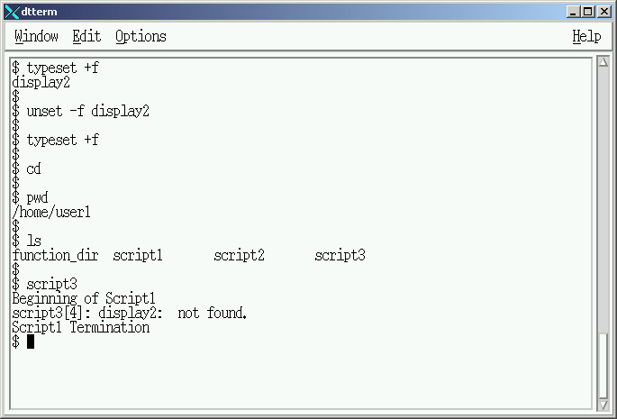
Execution of ‘script3’ - failure

Slide 47
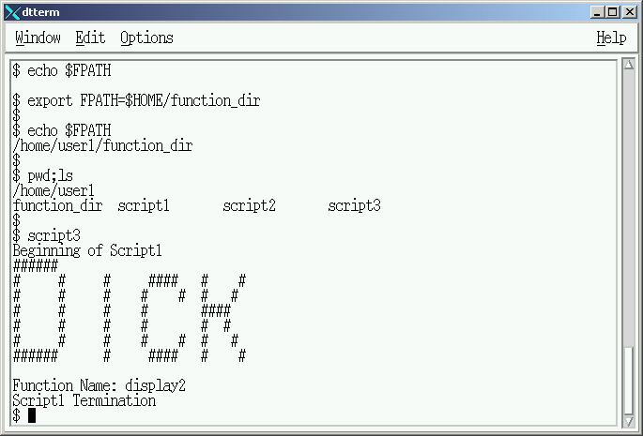
Execution of ‘script3’ - Success

Slide 48
Data Control and Functions
Lab #3 Assigned

Slide 49
Lab 3 – General Instructions
Create a data collection and display script displaying administrative information about the script environment
Incorporate and Launch the script from the Menu created in Lab 2.

Slide 50
Lab 3 – General Instructions
Headings documentation requirements:
  Name
  Course
  Lab
  Date
Document command usage on first instance only

Slide 51
Lab 3 – General Instructions
Shellscripts MUST be completed ontime
Assigned Due Date:
  Run shellscripts for instructor
  Turn-in hardcopy of all shellscripts

Slide 52
Lab 3 – Preparations
Launch Lab3 from your Menu System
Dynamically select Foreground and Background colors
  Clear and paint screen with selected colors and the ‘tput’ command
  Use RANDOM variable and Variable concatenation
  Dynamic screen colors are to be defined in a function

Slide 53
Lab 3 – Preparations
Create three variables as follows:
  ‘Pr’ with a value of “Process”
  ‘Pa’ with a value of “Parent”
  ‘ID’ with a value of “id”
Protect these variables from modification

Slide 54
Lab 3 – General Information
Display “General Information” as a constant in the middle of a line at the top of the screen
Display your login name (ie: shell101)
  Use ‘print’ command for screen format
  Field Heading: “Login Name : “
    Create heading using constants
  Content obtained from appropriate Korn Shell Variable

Slide 55
Lab 3 – General Information
Display your User Identification # (ie:201)
  Use ‘print’ command for screen format
  Field Heading: “User-id : “
    “User-” displayed as a constant
    “id” displayed from variable “ID”
    “:“ displayed as a constant
  Content created using ‘id’ and ‘cut’ commands
    ‘cut’ once by field
    ‘cut’ once by column

Slide 56
Lab 3 – General Information
Display Shellscript Name
  Use ‘print’ command for screen format
  Field Heading: “Process Name: “
    “Name:” displayed as a constant
    “Process” displayed from variable “Pr”
  Content created using appropriate System variable

Slide 57
Lab 3 – General Information
Display Process ID of Shellscript
Use ‘print’ command for screen format
  Field Heading: “Process-id: “
    “-” “:” displayed as a constant
    “Process” displayed from variable “Pr”
    “id” displayed from variable “ID”
  Content created using appropriate System variable

Slide 58
Lab 3 – General Information
Pause execution for 10 seconds, randomly select a different set of colors and paint screen
Display “Script Environment” as a constant in the middle of a line at the top of the screen

Slide 59
Lab 3 – Script Environment
Display current type of shell being used
  Use ‘print’ command for screen format
  Field Heading: “Current Shell Type : “
    Use constants to create the heading
  Content obtained from appropriate Korn Shell variable

Slide 60
Lab 3 – Script Environment
Display Parent Process Name (ie: -ksh)
Use ‘print’ command for screen format
  Field Heading: “Parent Process Name: “
    “Name” “:” displayed as a constant
    “Process” displayed from variable “Pr”
    “Parent” displayed from variable “Pa”
  Content created using ‘ps’ ‘grep’ ‘grep –v’ and ‘cut’ commands plus ‘$PPID’ variable

Slide 61
Lab 3 – Script Environment
Display Parent Process Identification #
Use ‘print’ command for screen format
  Field Heading: “Parent Process-id: “
    “-” “:” displayed as a constant
    “Process” displayed from variable “Pr”
    “Parent” displayed from variable “Pa”
  Content created using appropriate Korn Shell variable

Slide 62
Lab 3 – Script Environment
Display Seconds Parent has been active
Use ‘print’ command for screen format
  Field Heading: “Accumulated Seconds: “
    Create heading using constants
  Content created using appropriate Korn Shell variable

Slide 63
Lab 3 – Script Environment
Pause execution for 10 seconds, randomly select a different set of colors and paint screen
Display “Directory Information” as a constant in the middle of a line at the top of the screen

Slide 64
Lab 3 – Directory Information
Display the following Directory Information using ‘print’ command for screen format
  Field Heading: “Home Directory = “
  Field Heading: “Current Directory = “
    Randomly select different foreground and background colors for these fields ONLY
    Return to Original screen colors after display
  Content obtained using appropriate Korn Shell variables

Slide 65
Lab 3 – Directory Information
Display the following constant in Reverse Video, prompting the user for a directory to move to.
  “ Enter FULL pathname of next directory: “

Slide 66
Lab 3 – Directory Information
Force the user to enter a directory pathname (ie: /tmp) on the same line as the prompt.
  Use the “\c” option of the ‘print’ command
  Enter the new directory using ‘read’ command
  Store the directory name in the default variable supplied by the Korn Shell
  Move to the new directory
Turn off Reverse Video

Slide 67
Lab 3 – Directory Information
Display the following Directory Information using ‘print’ command for screen format
  Field Heading: “Current Directory = “
  Field Heading: “Previous Directory = “
    Randomly select different foreground and background colors for these fields ONLY
    Return to Original screen colors after display
  Content obtained using appropriate Korn Shell variables

Slide 68
Lab 3 – Script Environment
Pause execution for 10 seconds set foreground color to ‘white’ and background color to ‘black’ and paint screen
Return to your Menu System and Exit back to Unix prompt.

Slide 69
Data Control and Functions
Lesson #4 - Completed

